Slide 1

Chapter 10
Set and Dictionary

Slide 2
Content
Data structures
Set
Definition
Create
Run through
Methods
Dictionary
Definition and applicability
Creating key/value pairs
Retrieve values through key and method get()
Deleting key/value pairs: del and method clear()
Methods keys(), values(), items()
Sort

Slide 3
Data structures
Bundling data in lists or tuples isn’t always optimal.
There are also data structures that are often more efficient at addressing a problem and writing a program.
Set
Dictionary

Slide 4
Collection = Set
A set is a collection unique elements, an individual element can only be stored once.
The set does not have a specific order; the elements can be returned by iterator in a different order than the one in which they were entered.
The order can even change if you run the program twice
Individual elements of a set are not changeable
But you can remove an item or add a new one

Slide 5
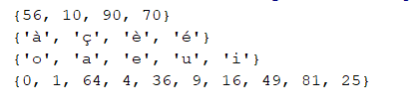
Create set
To create a set:
this_set = {elem1, elem2, elem3,...} # use a literal
this_set = set() # or use the set() constructor
this_set.add(elem1) # and add elements later
this_set = set(iterable_element) # e.g.: string, tuple, list, …
numbers = {10, 90, 70, 56} french_letters = set() for sign in "éçàèéàèçé": french_letters.add(sign) vowels = set('aeiou') squares = set(x**2 for x in range(10)) print(numbers) print(french_letters) print(vowels) print(squares)

Slide 6
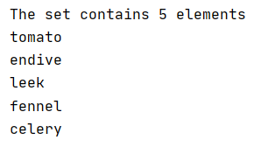
Move through the set
You can go through a set with a for loop
There is no way to determine the order in which you will see the elements
With len() you can print the size of the set
vegetables = {"leek", "tomato", "celery", "endive", "fennel"} print('The set contains', len(vegetables), 'elements') for element in vegetables: print(element) print()

Slide 7

Move through the set
You cannot sort the elements of a set. (A set is unordered)
You can use a list casting to convert the set into a list, and then sort that list.
vegetables = {"leek", "tomato", "celery", "endive", "fennel"} vegetable_list = list(vegetables) vegetable_list.sort() for element in vegetable_list: print(element)

Slide 8

Set: methods
These methods change the set and return value None as a result
vegetables = {'tomato', 'celery', 'endive', 'fennel' } print(vegetables) vegetables.remove('celery') print(vegetables) vegetables.add('lettuce') vegetables.add('leeks') print(vegetables) vegetables.clear() print(vegetables)

Slide 9

Set: methods
These methods result in a new set
union delivers a set that contains all the elements of both sets
difference delivers a set that only occurs in the first set and not in the second set.
intersection delivers a set that contains the elements that both sets have in common
vegetables1 = {'tomato', 'celery', 'endive', 'fennel' } vegetables2 = {'cucumber', 'tomato', 'celery'} vegetable_union = vegetables1.union(vegetables2) vegetable_difference = vegetables1.difference(vegetables2) vegetable_intersection = vegetables1.intersection(vegetables2) print('union:', vegetable_union) print('difference:', vegetable_difference) print('intersection:', vegetable_intersection)

Slide 10
Set: methods
You can achieve the same by using operators (I, -, &) instead of methods:
vegetables1 = {'tomato', 'celery', 'endive', 'fennel' } vegetables2 = {'cucumber', 'tomato', 'celery'} # vegetable_union = vegetables1.union(vegetables2) vegetable_union = vegetables1 | vegetables2
# vegetable_difference = vegetables1.difference(vegetables2) vegetable_difference = vegetables1 - vegetables2
# vegetable_intersection = vegetables1.intersection(vegetables2) vegetable_intersection = vegetables1 & vegetables2

Slide 11
Set: other methods
issubset True if all elements of the first set are also present in the set, which you specify as parameter
issuperset True if all elements of the set, which you specify as parameters, are also present in the first set
isdisjoint True if both sets have no elements in common
vegetables1 = {'tomato', 'celery', 'endive', 'fennel' } vegetables2 = {'cucumber', 'tomato', 'celery'} vegetables3 = {'endive', 'fennel'} print(vegetables2.issubset(vegetables1)) #False print(vegetables3.issubset(vegetables1)) #True print(vegetables1.issubset(vegetables1)) #True print(vegetables2.issuperset(vegetables3)) #False print(vegetables1.issuperset(vegetables3)) #True print(vegetables1.isdisjoint(vegetables2)) #False print(vegetables2.isdisjoint(vegetables3)) #True

Slide 12
Dictionary: introductory example
Suppose, for example, you want to keep track of how often a character occurs in the word 'hottentot'
With our current knowledge of data structures we would make 2 lists:
a list of characters
a list of the number of times the character appears on the corresponding index position
word = 'hottentot' characters = ['e', 'h', 'n', 'o', 't'] occurrence = [1, 1, 1, 2, 4]

Slide 13
Data structures
If we now want to know the frequency of a certain character, we first have to look it up in the characters list in order to know the index position that we have to retrieve in the occurrences list.
In this situation it would be more convenient to keep the characters and the number of times they occur together in one data structure.
A suitable type of structure is a:
dictionary: a unique ordered** collection of key-value pairs which is changeable
word = 'hottentot' characters = ['e', 'h', 'n', 'o', 't'] occurrence = [1, 1, 1, 2, 4] print('Occurrences of letter t:', occurrence[characters.index('t')])

Slide 14
Dictionary
A dictionary is an ordered**, changeable collection of key-value pairs
(** from Python 3.7 onwards)
The key is unique so you can use it to retrieve any value
You can imagine a dictionary as a table with two columns
letters = {'e': 1, 'h': 1, 'n': 1, 'o': 2, 't': 4}
Key | Value
e | 1
h | 1
n | 1
o | 2
t | 4
A dictionary is created via curly braces: {}
Key and value are separated by a :
Key/value pairs are separated by a , dictionary = {key 1: value 1, ... , key n: value n}

Slide 15

Retrieve value via key
Looking up a value is done by the key
First method
The key is given 'as an index' in square brackets
Key | Value
e | 1
h | 1
n | 1
o | 2
t | 4
letters = {'e': 1, 'h': 1, 'n': 1, 'o': 2, 't': 4} print('Occurrences of letter t:', letters['t'])

Slide 16


Retrieve value via key
Second method
A dictionary also has a method to retrieve the value associated with a key.
The advantage of the method get()is that you can decide what is returned if the key is not found.
letters = {'e': 1, 'h': 1, 'n': 1, 'o': 2, 't': 4} my_choice = input('Letter? ') print(letters.get(my_choice, 'This character does not occur'))

Slide 17
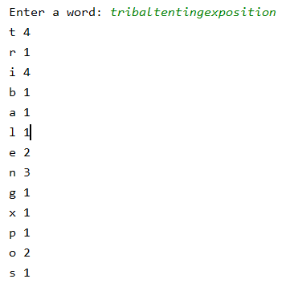
Example: count letters
word = input('Enter a word: ') characters = {}
# go through letters in word for letter in word: # check if letter is present in dictionary if letter in characters: characters[letter] += 1
# increase value via key else: characters[letter] = 1
# create new key/value pair
# print key/value pairs for char in characters: print(char, characters[char])

Slide 18
Change content dictionary
When assigning a value to a key:
If a key already exists, its value is overwritten
If a key does not exist, a key/value pair is automatically created
Checking if a key exists can be done using the IN keyword
# check if letter is present in dictionary if letter in characters: characters[letter] += 1 # increase value via key else: characters[letter] = 1 # create new key/value pair

Slide 19


Go through content dictionary
You can use a for loop to run through the content of a dictionary
Note that the iterator runs through the keys of the dictionary and not the values!
Using the key you can, of course, request the value.
key
value

Slide 20
Remove from dictionary
Using the keyword del you can delete a key/value pair
Using the method clear() you can empty the entire dictionary
del characters['e']
characters.clear()

Slide 21
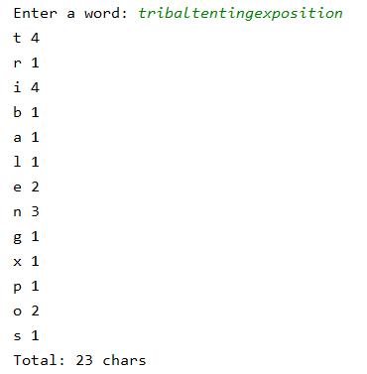
Methods keys() and values()
If you don't want to work with pairs but with the keys and the values separately, you can retrieve these iterators using the methods keys() and values().
For example, suppose you want to know the total number of characters based on the dictionary:
# total number of letters print('Total:',sum(characters.values()), 'chars')

Slide 22



Dictionary sorting by key
By definition, a dictionary is a collection of (un)ordered** key-value pairs.
There is no method to sort the pairs internally.
With the help of the sorted() function you can show the pairs sorted
for character in sorted(characters): print(character, characters[character])
for character in sorted(characters, reverse=True): print(character, characters[character])
22

